Slide 1
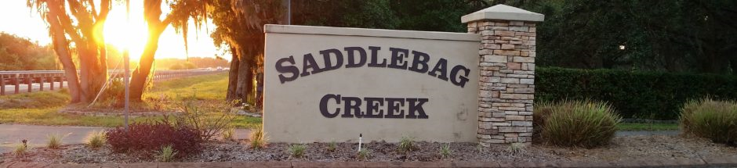
  Welcome!
  2022 Saddlebag Creek Ranches Home Owners Association Annual Meeting

Slide 2
Saddlebag Creek Ranches Homeowners’ Association
Saddlebag Creek Ranches – 2022 Annual Meeting
Agenda
    Attendance sign in sheet - name(s), lot number(s), email address
    Property owners introductions
    Roll call of directors & certification of proxies – appt. election chair
    Prior meeting minutes – posted to website
    2020, 2021, & 2022 YTD Review
      Board roles
      Financial reports – provide email address if you request copies, 1 copy here
      Committee accomplishments
    2022 Priorities
    Election of new officers
    Adjournment
    Board meeting

Slide 3
Saddlebag Creek Ranches Homeowners’ Association
Saddlebag Creek Ranches – 2022 Annual Meeting
Board Member Roles
All – meeting participation, decision making, consistent support of multiple community needs!
Tom Bardroff – general maintenance (stepping down)
Jack Duich – administration, external liaison, governance, roads project, ARC
Jim Moore – swale & drainage project, sprinklers
Jeff Sherman – legal guidance & other duties as requested
Tim Strausbaugh – entrance/sprinklers, all around handyman
(Special thanks to Jessie Duich for accommodating every BOD meeting at her residence!)

Slide 6
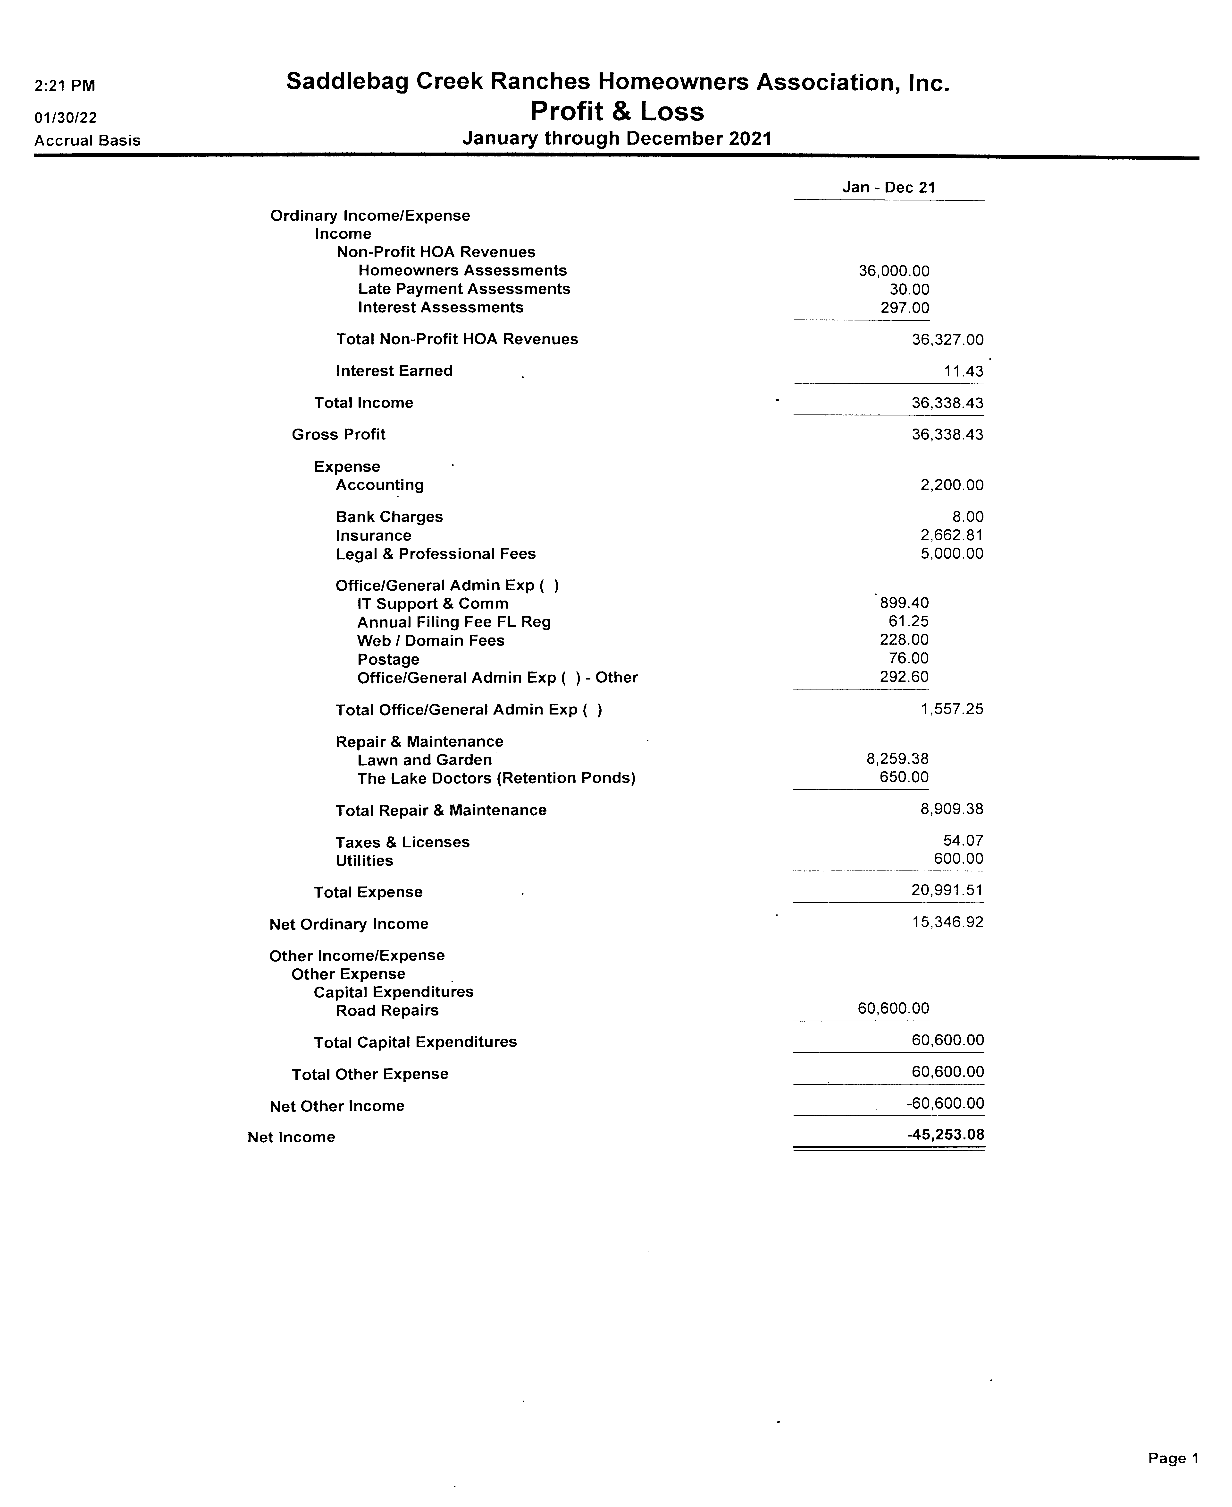

Slide 7
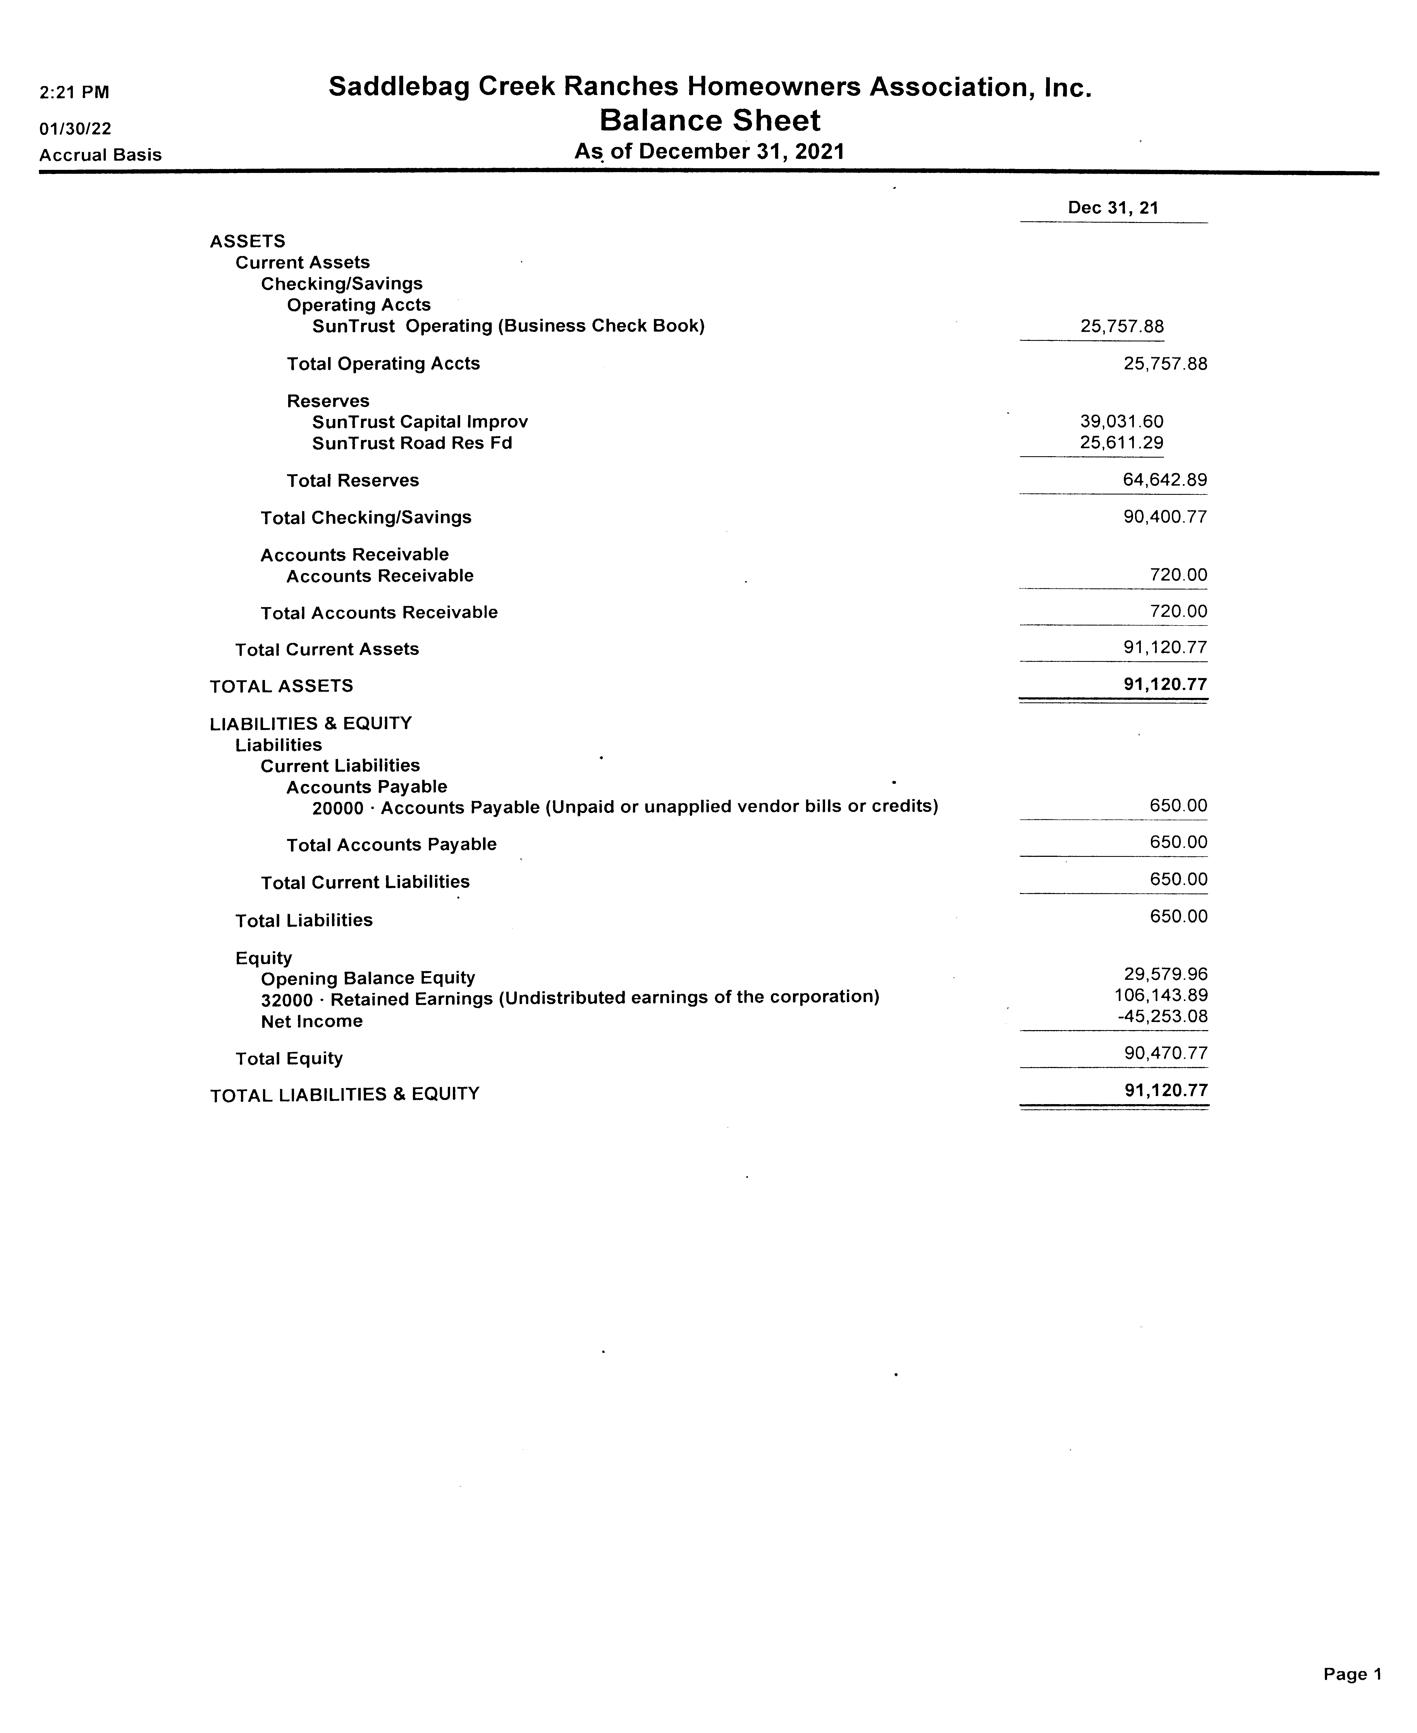

Slide 8
Draft budget pg 1

Slide 9
Draft budget pg 2

Slide 10
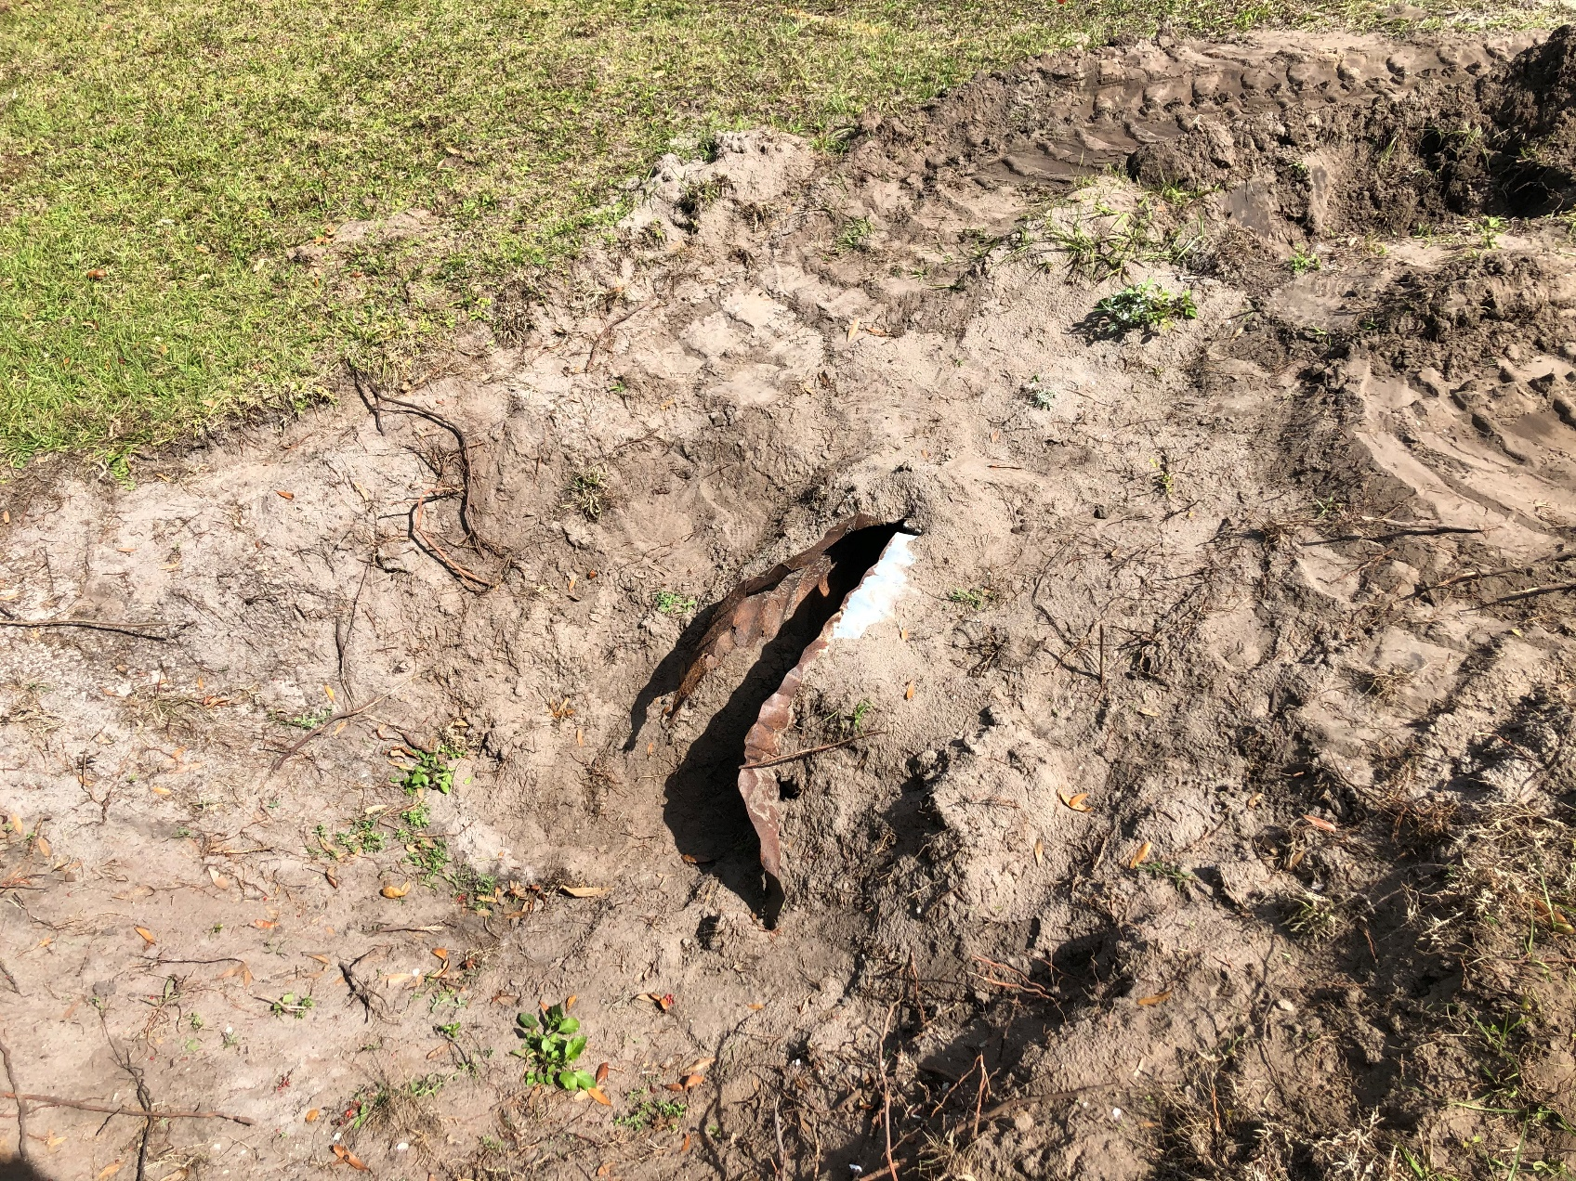
2020 & 2021 accomplishments
Bridle trails clearing (Flottemesch easement opens new trail, Bill Zinn now mowing)
Swales & drainage project completed incl. CMP replacement

Slide 11
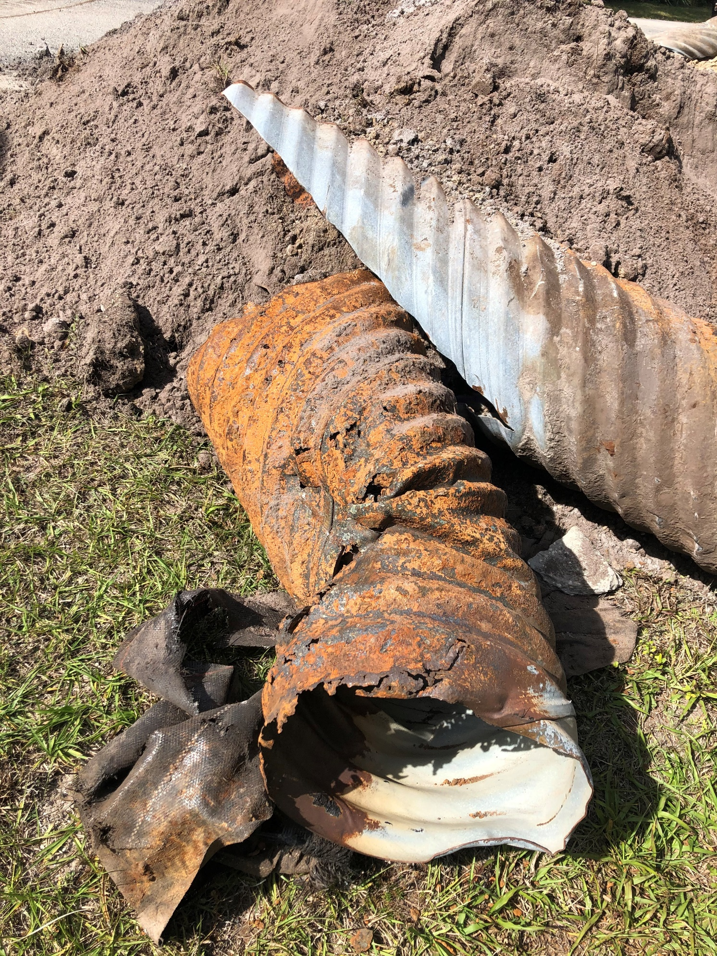
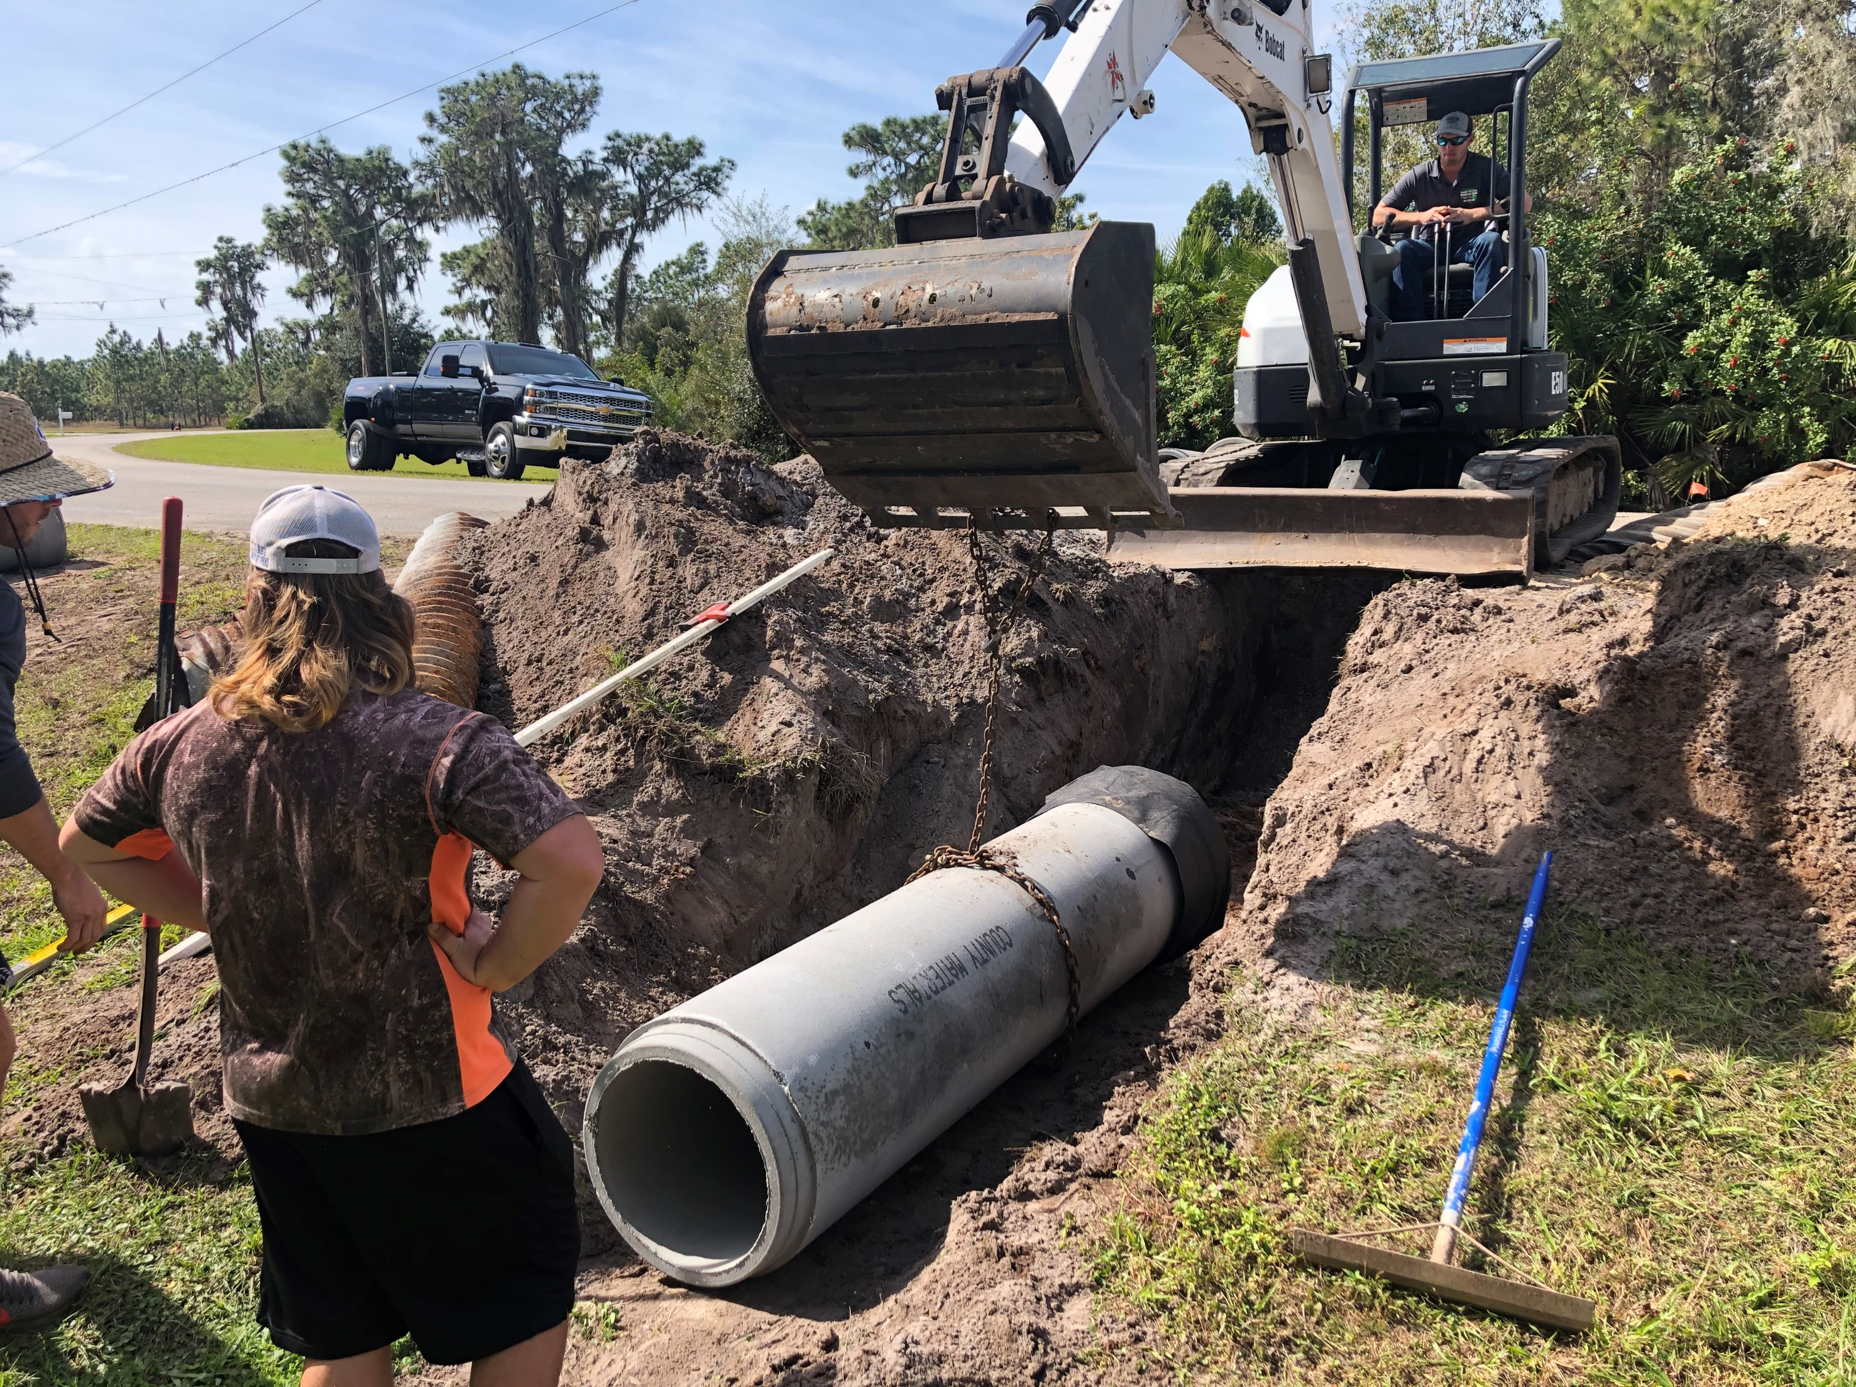
2020 & 2021 accomplishments

Slide 12
2021 & 2022 YTD accomplishments / highlights
Road repairs & repaving
  future costing depending on cost of resources (oil, labor, etc.)
  $60K for High Oaks Trail (today’s $)
  $95K for balance of Saddlebag Trail (today’s $)
  5-7 year life expectancy for current “old” roads (@ today’s usage)
  Barring unanticipated major expenses, potential to keep dues @ $600/yr .
Entrance bed replanting & sprinkler maintenance (ongoing) Many thanks to Tom, Tim, Jim!
Medieval Fair concern engagement ($5,000 legal fees)
Community yard sale – Many thanks to Rose Riggle
FDOT SR70 double-line repainted

Slide 13
2022 Priorities
  Maintenance of community assets [repair/restoration]
    Roadways – continue to monitor
    Emergency swale restoration near Champ property
  Assist property owners with new construction & improvements
  Monitor / anticipate / react to possible adjacent development (including egress off HOT easement)
    Need community attention to news / events/ rumors
    Could involve legal fees
  2022 Medieval fair

Slide 14
2022 Board Of Directors Election
  2022 Director nominees: one year terms. 3 directors minimum, 5 ideal, 7 maximum
  Jack Duich
  Jim Moore
  Jeff Sherman
  Tim Strausbaugh
  Other write-ins (at annual meeting)
  Please submit hand carried ballots to election chairperson (Patti C.?)
  Results upon tally
  Next board meeting tonight then every 6-8 weeks

Slide 15
Adjournment
  Thank you for your participation!

