Slide 1
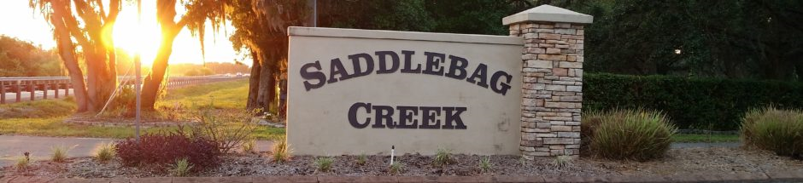
  Welcome!
  2024 Saddlebag Creek Ranches Home Owners Association Annual Meeting

Slide 2
Saddlebag Creek Ranches Homeowners’ Association
Saddlebag Creek Ranches – 2024 Annual Meeting
Agenda
    Attendance sign in sheet - name(s), lot number(s), email address
    Property owners introductions
    Roll call of directors & certification of proxies – appt. election chair
    Prior meeting minutes – posted to website
    2023 & 2024 YTD Review
      Board roles
      Financial reports – provide email address if you request copies, 1 copy here
      Committee accomplishments
    2024 Priorities
    Election of new officers
    Adjournment
    Board meeting

Slide 3
Saddlebag Creek Ranches Homeowners’ Association
Saddlebag Creek Ranches – 2024 Annual Meeting
Board Member Roles
All – meeting participation, decision making, consistent support of multiple community needs!
Jack Duich – administration, external liaison, governance, roads project, ARC
Jim Moore – swale & drainage project, sprinklers
Jeff Sherman – legal guidance & other duties as requested
Tim Strausbaugh – entrance/sprinklers, all around handyman
Marcela Serio – newer member, not yet a resident, role TBD

Slide 8
2023 & 2024 YTD accomplishments / highlights
Front entrance fire pond emergency swale remediation (back to “as built”).
Sprinkler system filter construction – clog avoidance (Tim & Jim)
Entrance bed replanting & sprinkler maintenance 2023 until April 2024 (Tim & Jim)
Damage repair at entrance (x2)
Two fire ponds roadway facing swales cleared (need to grind stumps)
New lawn service chosen (from 3 candidates)
Multiple ARC submissions / reviews / approvals (additions, outbuildings, & pool)
Community yard sale – Many thanks to Rose Riggle
Ongoing BOD meetings – thanks to Jessie Duich for hosting

Slide 9
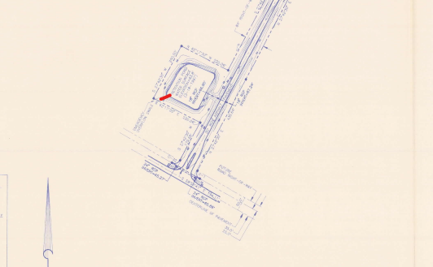
2023 Fire pond swale remediation

Slide 10
2024 Priorities
  Maintenance of community assets [repair/restoration]
    Roadways – continue to monitor
    Road repairs & repaving
      future costing depending on cost of resources (oil, labor, etc.)
      $60K for High Oaks Trail (2023 $)
      $95K for balance of Saddlebag Trail (2023 $)
      5-7 year life expectancy for current “old” roads (@ today’s usage)
    Entrance condition & beautification
    Signs
  Assist property owners with new construction & improvements
  Monitor / anticipate / react to possible adjacent development including egress off HOT easement)
    Need community attention to news / events/ rumors
    Another year of Medieval Fair
  Other needs / ideas?

Slide 11
2024 Board Of Directors Election
  2024 Director nominees: one year terms. 3 directors minimum, 5 ideal, 7 maximum
  Jack Duich
  Jim Moore
  Jeff Sherman
  Tim Strausbaugh
  Marcela Serio
  Other write-ins (at annual meeting)
  Please submit hand carried ballots to election chairperson (Lance)
  Results upon tally
  Next board meeting tonight then every 6-8 weeks

Slide 12
Adjournment
  Thank you for your participation!

